Slide 1
SUDOKU SOLVER
By: Dunni Adenuga
Timothy Woodford
Andrew Nyhus

Slide 2
Background/Problem Domain
What is Sudoku?
Puzzle constraints
Overview: Solving sudoku
Solve puzzles manually
Use algorithms
Algorithms
Optimization algorithms
Computational complexity

Slide 3
User Stories
As a player, I want to be able to enter my own board, so that I can play the game or the computer can solve my puzzle for me
As a player, I want the computer to be able to generate the board for me with varying difficulty, so that I can play the game or the computer can solve the game
As a player, I want to be able to manually solve the puzzle
As a player, I want the computer to be able to solve the puzzle using three different algorithms

Slide 4
Scrum Experience
Process
Trello/Burndown for Trello
Strengths
Intuitive GUI
Design of Backend
Git
Challenges
Implementing solving algorithms
Interface between model and view
Turning solved Board to actual puzzle

Slide 5
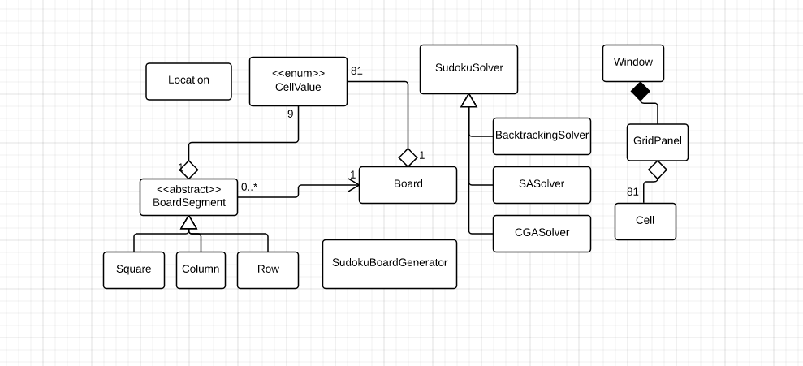
Design & Implementation
-UML DIAGRAM
Notes:
See this new diagram: https://www.lucidchart.com/invitations/accept/fe22bdf5-0315-4168-a194-4526cef45e2b

Slide 6
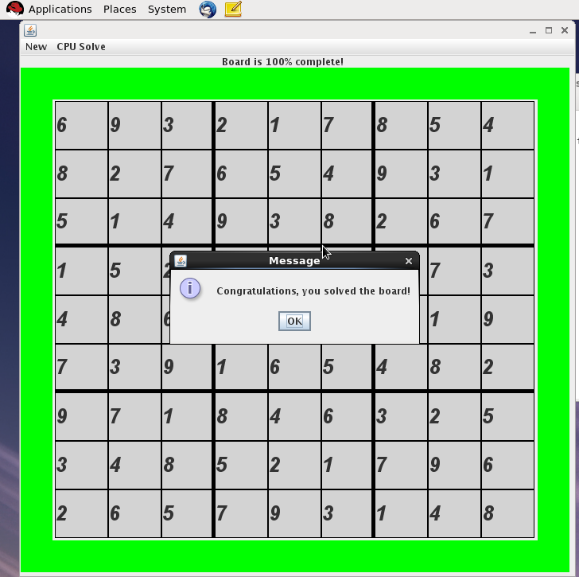
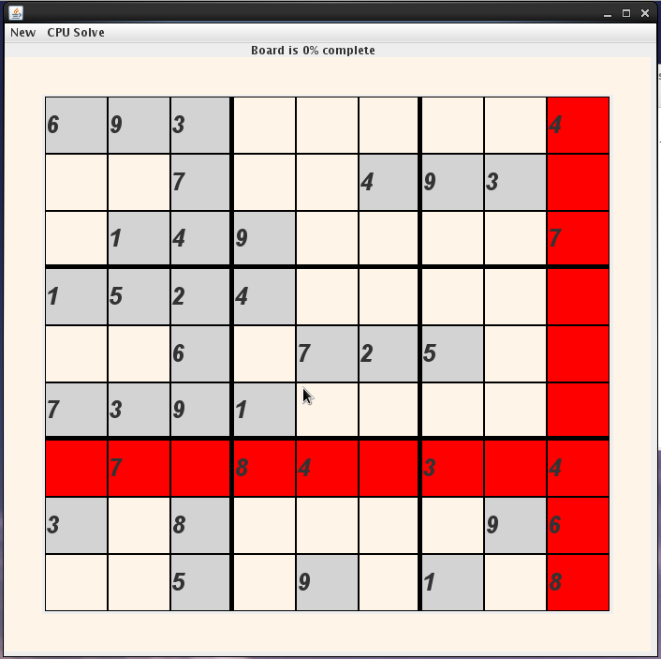
USER INTERFACE
Screen-Shot

Slide 7
DEMONSTRATION

Slide 8
Conclusion
What we learnt/Challenges
Google is your best resource
Debugging exceptions that pertain to one of the 81 custom JTextFields (Sudoku View Cells), when the stack trace points only to java library files
In general figuring out why a few Cells may act improperly when the majority function as intended
v. 2.0
Make mode of generating boards more sophisticated
More interactive GUI
Cleaner code in SudokuController class

